Slide 1


The Group: Group Project 1
The Group: Garret Church, Mark Lawton, Christopher Bushman,
Luis Melendez, and Artur Tarverdyan
Professor Smith
CIT 480
11/2/19
Notes:
Greet the audience and introduce yourselves.

Slide 2
Topics
EC2 Instances
VPC
Ansible Playbook
Lambda Function
IAM User
What went wrong!

Slide 3
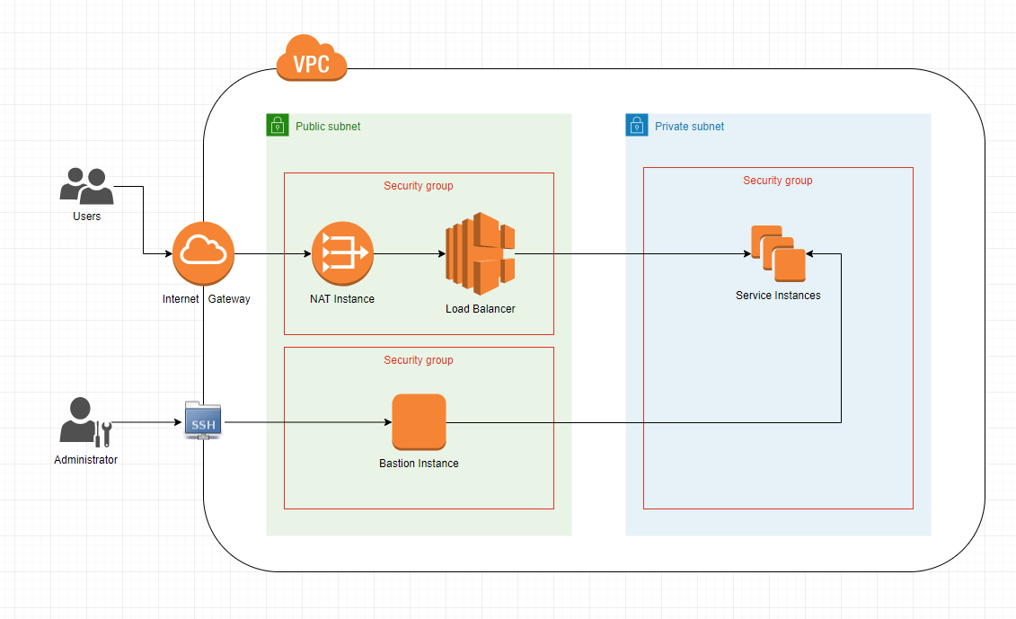
Network Diagram

Slide 4
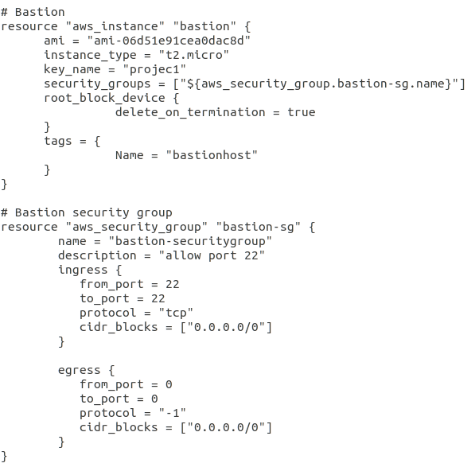
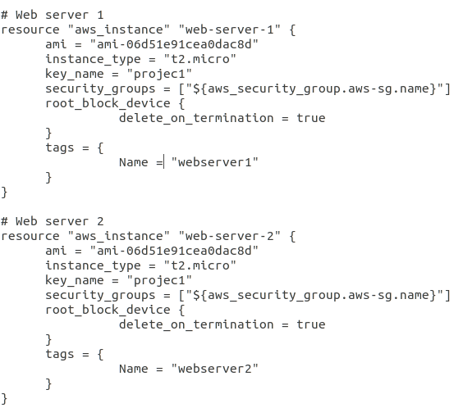
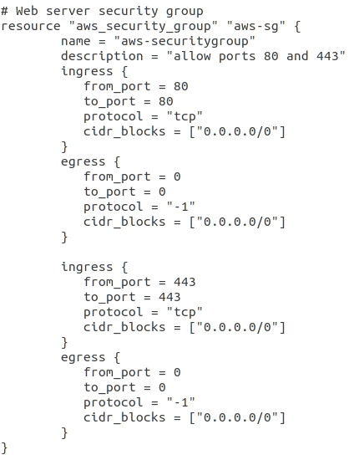
EC2 Instances
Bastion Host and its Security Group
Web Servers
Web Server Security Group
Notes:
Mark

Slide 5
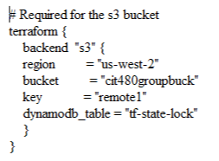
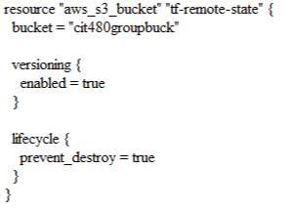
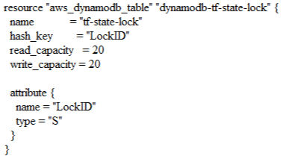
S3 Bucket
S3 Bucket Reference Block
S3 Bucket Container
Dynamodb Table
Notes:
Mark

Slide 6
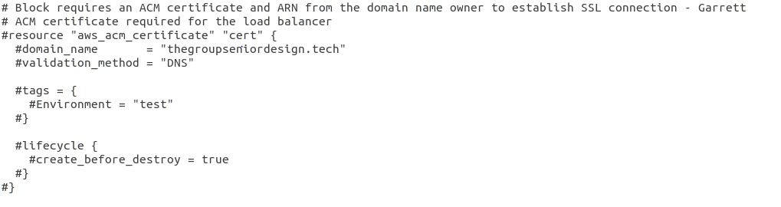
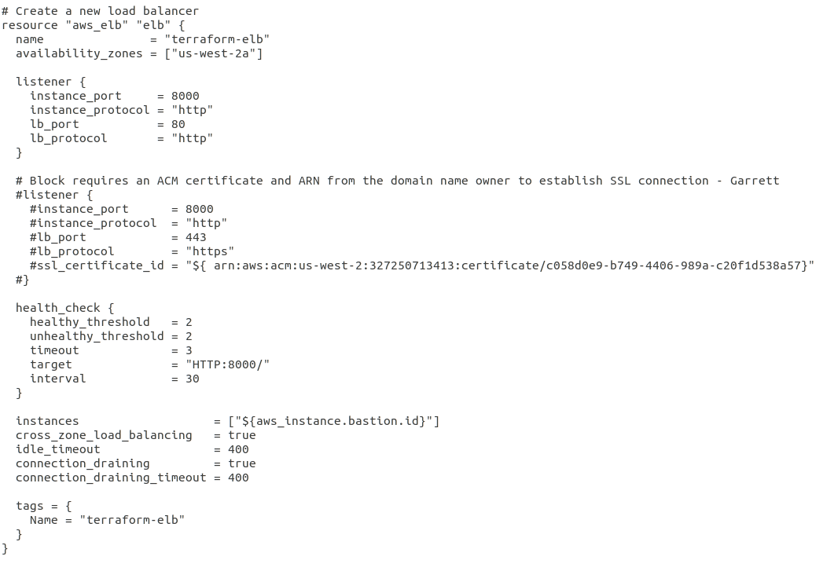
Elastic Load Balancer and ACM Certificate
ACM Certificate
Classic Load Balancer
Notes:
Mark

Slide 7
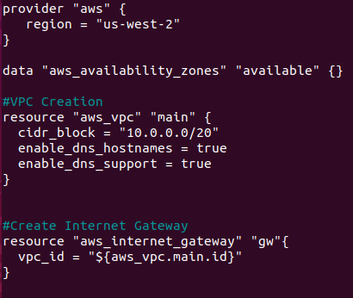
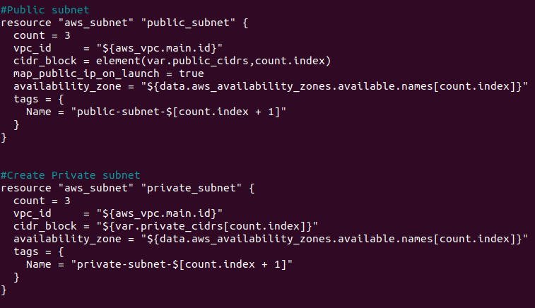
VPC
Virtual Private Cloud.
Internet Gateway.
Creating public and private subnets.
Count and index.

Slide 8
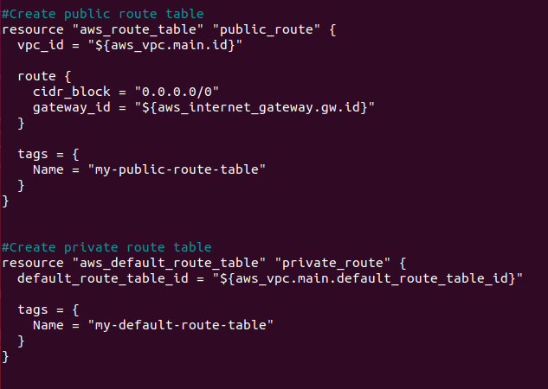
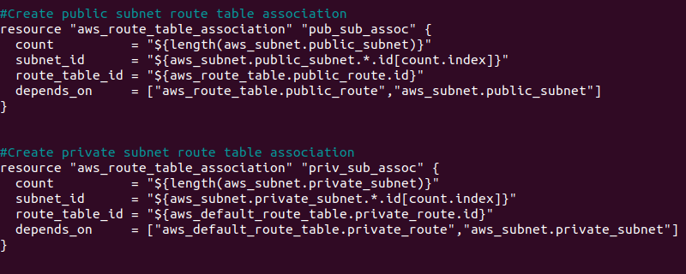
Route Tables
Public and private route tables.
Public and private subnet association using count + index.

Slide 9
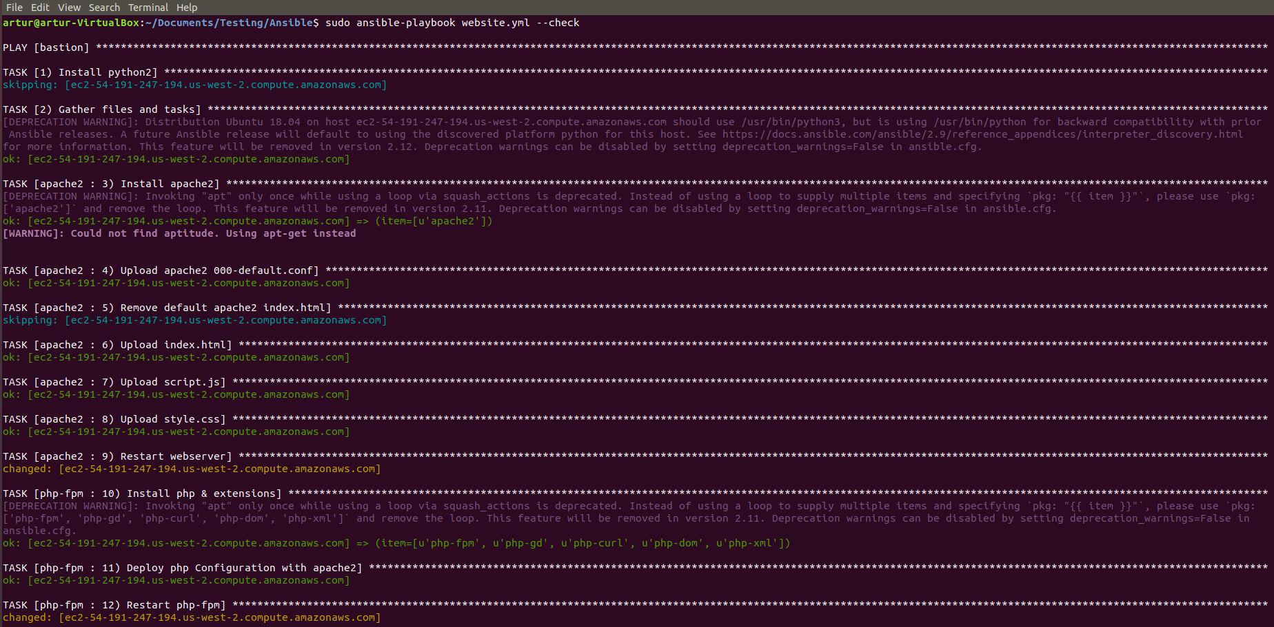
Ansible
Folder Structure
Ansible
fail2ban.yml
website.yml
hosts
roles
apache2
files
000-default.conf
index.html
script.js
style.css
tasks
main.yml
php-fpm
files
www.conf
tasks
main.yml
Notes:
Arthur

Slide 10
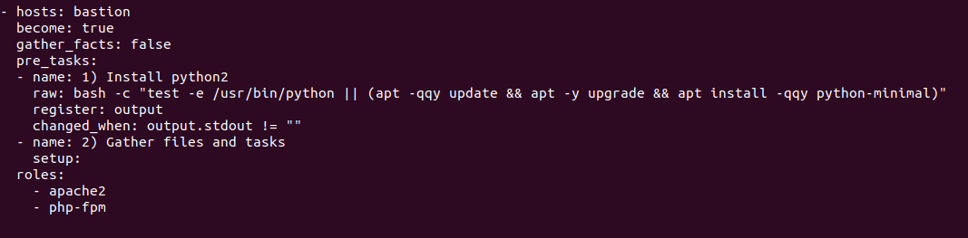
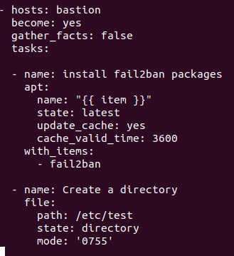
Ansible Playbooks
website.yml
fail2ban.yml

Slide 11
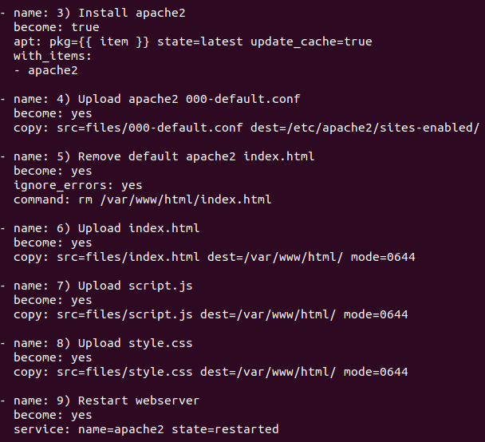
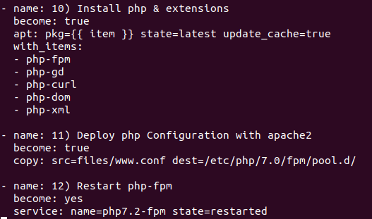
Ansible tasks
apache2 php-fpm

Slide 12
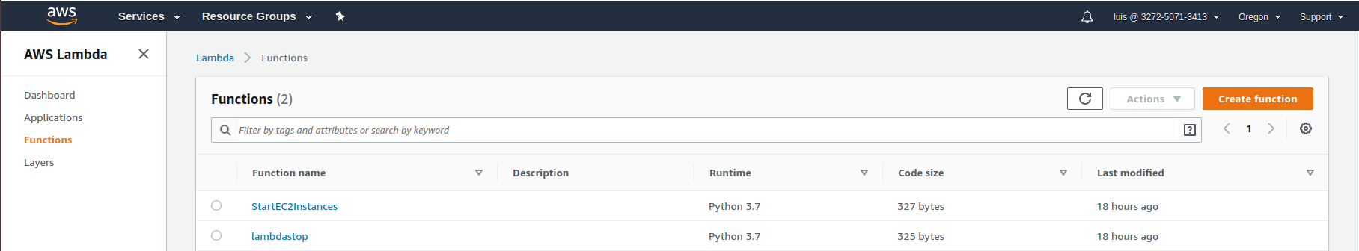
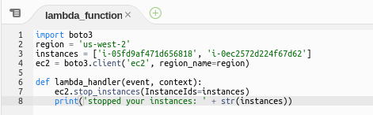

Lambda Function
Notes:
Luis

Slide 13
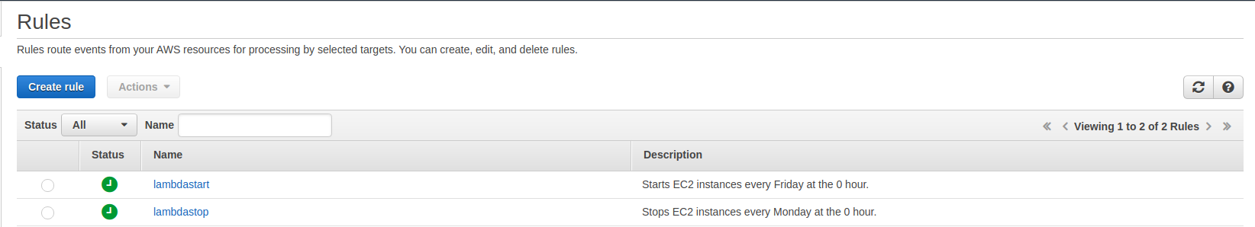
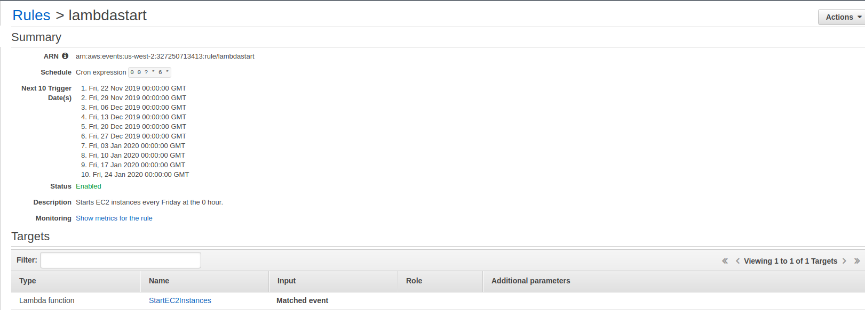
Lambda Rules
The parameters for the ‘Start’ rule were: 0 0 ? * 6 *. The first 0 is minutes, second 0 is hours, the question mark means that it is not executed on a specific day, the * is any day in the month, the 6 means Friday, and the last * means any year.
Notes:
Luis

Slide 14

IAM User
What it creates:
Multiple users
CIT 480 Group
Group Policy
Encrypted Passwords
Create Keybase Account
Add pgp key
Include pgp key in IAM_User.tf file for each user.
Send Encrypted passwords to the users.
User runs command “echo “<encrypted password>” | base64 --decode | keybase pgp decrypt”
Notes:
Garrett

Slide 15
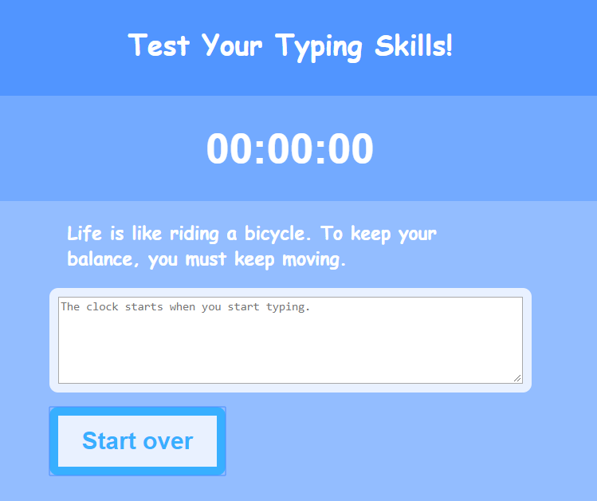
Web Application
Create a typing test website:
Index.html
Website structure (Header, Body, Footer)
Script.js
Running a stopwatch
Compare typed data with origin text
Start/stop session
Event listeners
Style.css
Website font and color modifications

Slide 16
What Went Wrong!
s3 Buckets: Kept receiving previous backend Error:
Ended up running “rm -rf .terraform” and then “terraform init”
EC2’s were being created with the default VPC even when referencing the subnet_id of the VPC’s we were creating.
Ansible seems to be installing LAMP on bastion instead of EC2s (Proxycommand?)

